Slide 1
Notice to Mariners Hydrographic Survey
Thurso to Hoy & Dunnet Head to Dunscanby Head

Slide 2
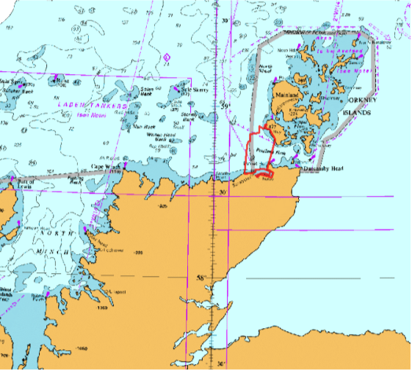
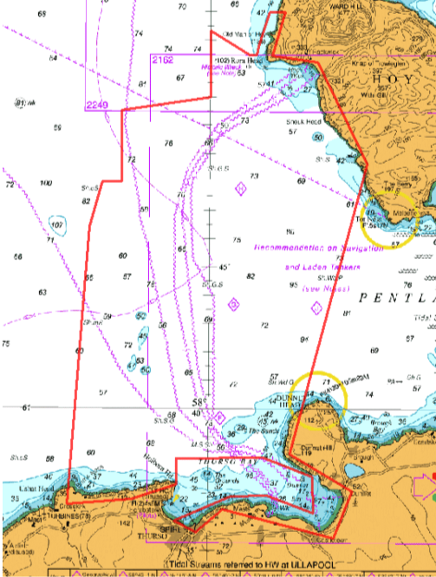
VESSEL: M/V LODE
MANEUVERABILITY: LIMITED
EQUIPMENT: MULTIBEAM
(Hull mounted and partically Towed )
PERIOD: 16th of May – 30th June2025
(partially during this period)
PURPOSE: UPDATING NAUTICAL CHARTS

Slide 3
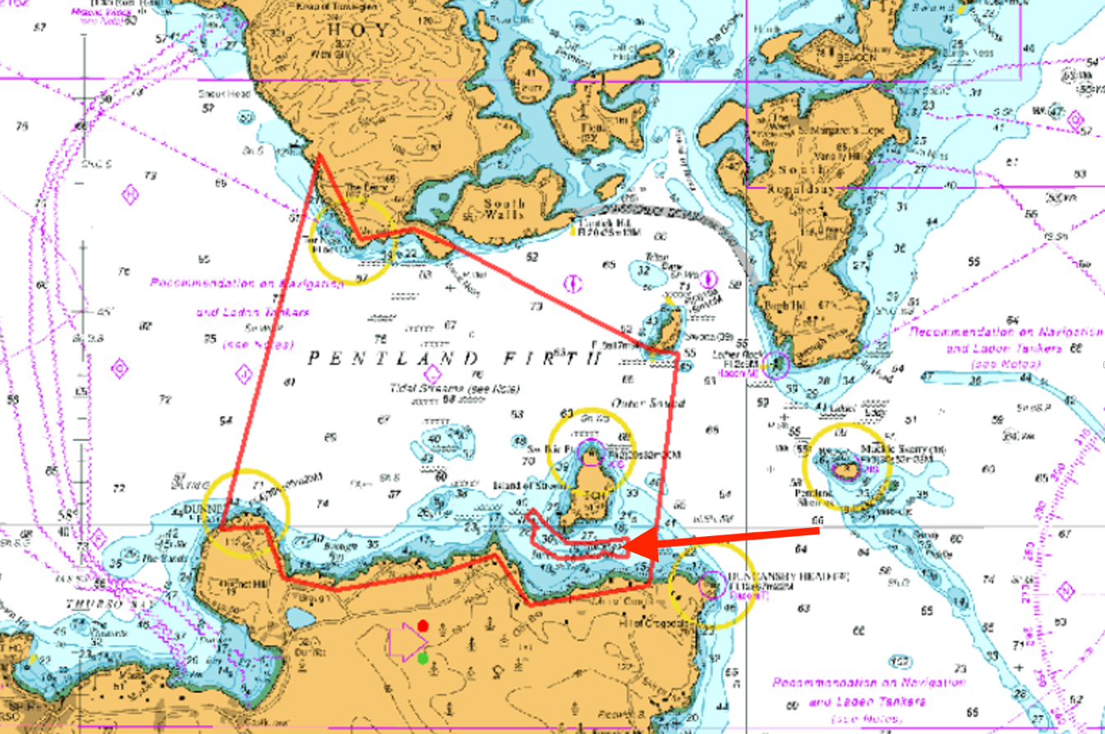

Slide 4
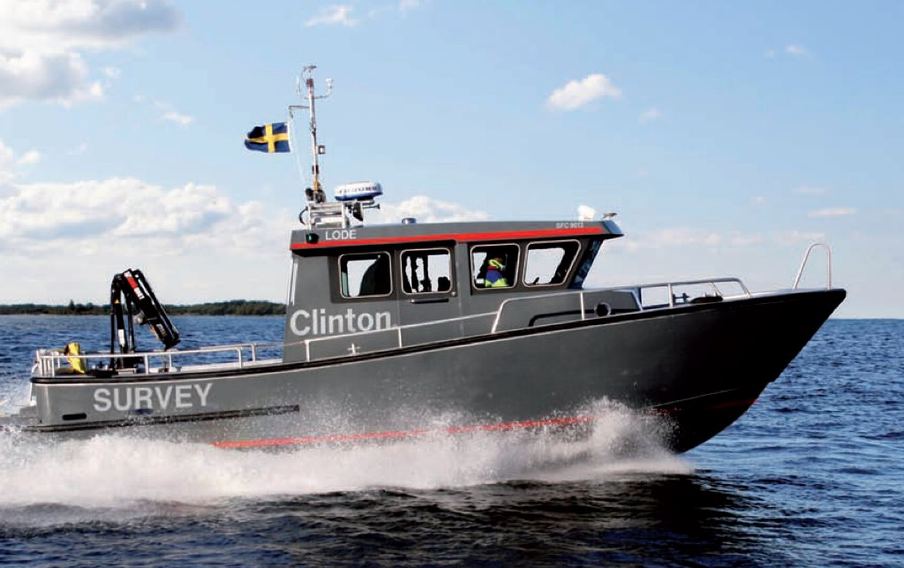
M/V Lode
Call sign: SFC9613
Bridge (VOIP): +46 10 402 31 29
Email: master-lode@njordsurvey.se
Contact person at Njord Survey: ​
Martin Wikmar +46 708 79 90 20​
Philip Ljungström +46 708 79 90 26

